Slide 1
the phoenix
version 2.0
Developer: Almog Levi
© All rights reserved - Almog Levi

Slide 2
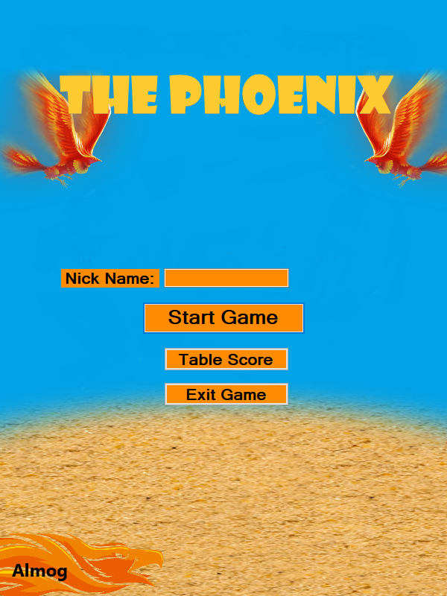
opening screen
How do you start playing?
Add nick name
Then Start Game
Or view on Table Score
Not recommended - Exit Game
© All rights reserved - Almog Levi

Slide 3
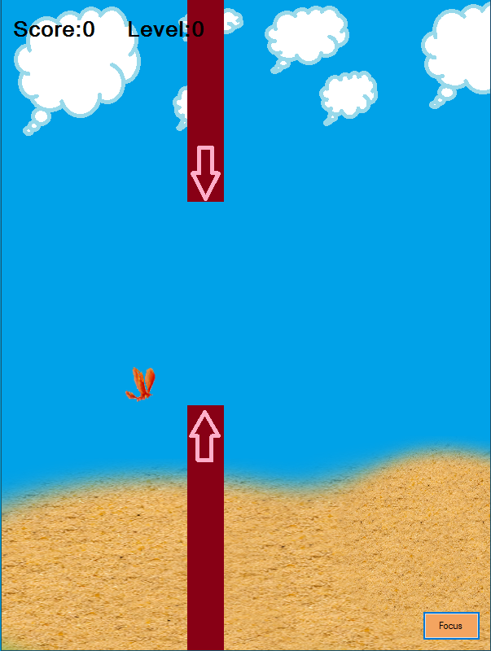
So what happens in the game
Score - Make sure you have the highest score
Level - Higher levels - speed increases
Player - Move between the walls and earn higher scores
Walls – If you touched them the game is over
How do I jump? – You have several choices:
Click with the mouse on the label -|“Focus”|
Press space key(in the Keyboard)
Press enter key(in the Keyboard)
© All rights reserved - Almog Levi

Slide 4
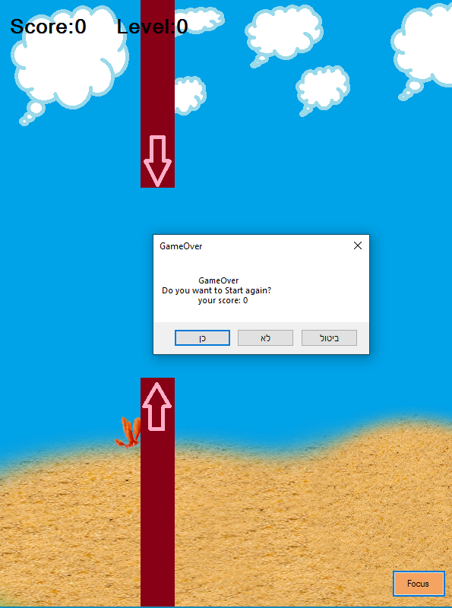
So what happens after the game is over?
You have several choices:
Play again
Back to the menu
Recommended to choose 1
© All rights reserved - Almog Levi

Slide 5
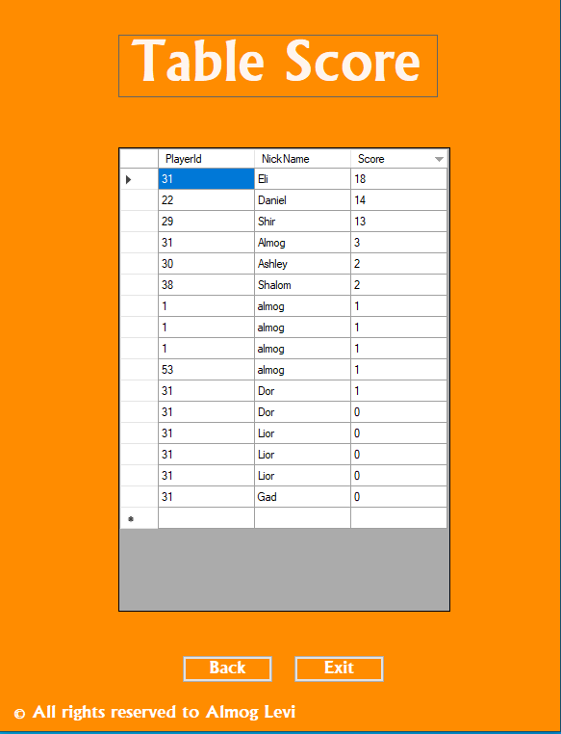

the cherry: a TABLE SCORE
Please nice name
So what we see here?
Player id – randomly
Nick Name – your name
Score - Who is bypassing Eli?
Back – to the Menu
Exit – from the game
© All rights reserved - Almog Levi

Slide 6
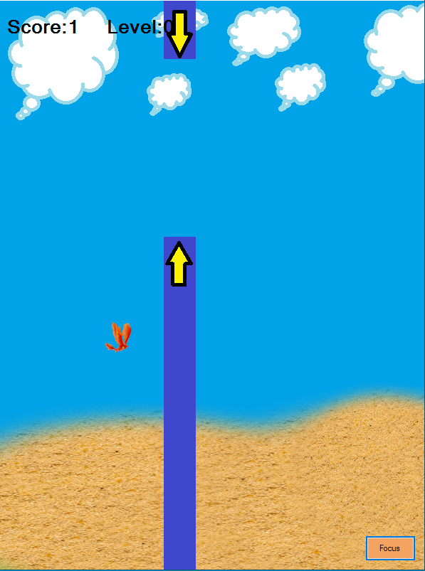
Spoiler from the game
If you reach the purple walls, you will feel like you are in an airplane.
© All rights reserved - Almog Levi

Slide 7

Updates to version 3.0
New speeds, and felling's
You chose the Player(image)
new levels
New designs
New maps
Multi Players
And more CHERRIES ☺
Version 3.0
© All rights reserved - Almog Levi

Slide 8
The celebration is over
I hope you enjoyed
Available in my mail: almoglevi19943@gmail.com
© All rights reserved - Almog Levi

